Slide 1
STOCK MARKET PREDICTION USING TIME SERIES ANALYSIS UMBC Data Science Master Degree Capstone by Dr. Chaojie (Jay) Wang
SHALINI MOPURI
Student ID: YG27415

Slide 2

TABLE OF CONTENTS
PROJECT OBJECTIVE
PROBLEM STATEMENT
DATASET DESCRIPTION
DATA DICTIONARY
DATA PREPROCESSING
EXPLORATORY DATA ANALYSIS
TIME SERIES ANALYSIS
MODEL TRAINING AND EVALUATION
WEB APP DEVELOPMENT
CHALLENGES
FUTURE WORK
CONCLUSION
RESEARCH QUESTIONS

Slide 3
PROJECT OBJECTIVE
The objective of this project is to develop a robust predictive model that can predict future stock process based on historical data. The model will use Time Series Analysis to identify patterns and trends in the stock market data and will be trained on a dataset of historical stock prices.

Slide 4
PROBLEM STATEMENT
The problem statement for this project is to develop a stock market prediction model that can accurately predict future stock prices based on historical data and other relevant factors. The model should be able to handle large amounts of data and should be able to adapt to changes in the market over time.

Slide 5
DATASET DESCRIPTION
Data Sources: The dataset used for this project was obtained from Yahoo Finance, which contains daily stock price data. The ticker covers a wide period, making it ideal for analyzing stock market trends and predicting future stock prices.
Link: https://finance.yahoo.com/markets/stocks/most-active/
Data Size: 2MB
Data Shape: 5033 rows and 6 columns.
Time period: 2004-11-20 to 2024-11-20

Slide 6
DATA DICTIONARY.
The dataset used in this project consists of historical stock market data collected from Yahoo Finance, spanning a 20-year period from 2004 to 2024.
COLUMN NAME | DATA TYPE | DEFINITION
Date | DateTime | The date on which the stock data was recorded.
Symbol | String(Categorical) | The ticker symbol of the stock.
Open | Float | The price at which the stock opened for trading on the day.
High | Float | The Highest price of the stock traded at during the day.
Low | Float | The Lowest price of the stock traded at during the day.
Close | Float | The Highest price of the stock traded at during the day.
Adj Close | Float | Adjusted closing price that accounts for dividends and stock splits.
Volume | Integer | The total number of shares traded during the day.

Slide 7
DATA PREPROCESSING
Data Cleaning
Removing inconsistencies and errors in the data to ensure accuracy
Standardize data formats for uniformity.
Handling missing values and detecting the outliers
Feature Engineering:
Calculate daily returns to capture stock performance.
Using moving averages to identify trends over different time periods.

Slide 8
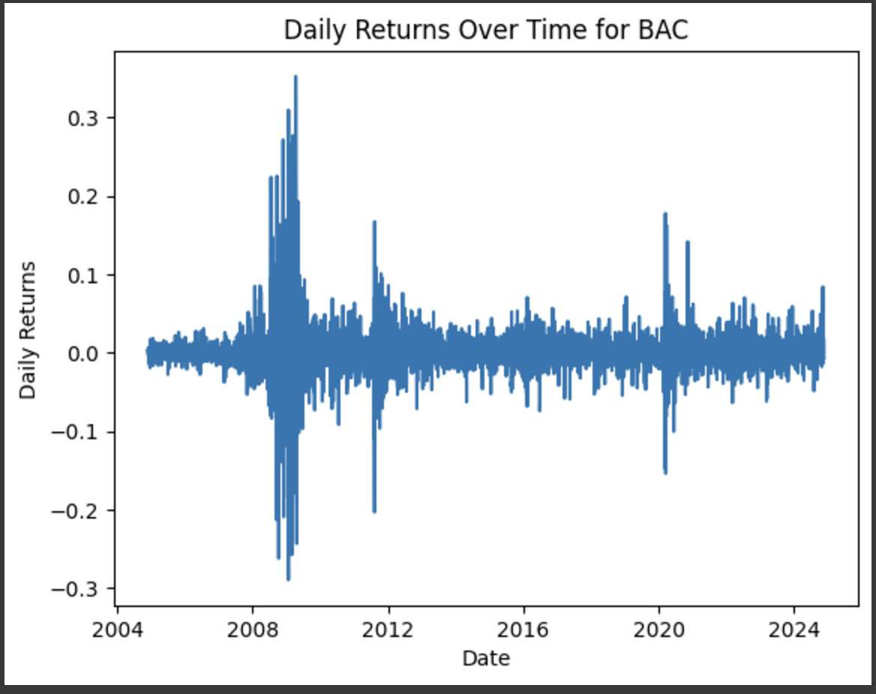
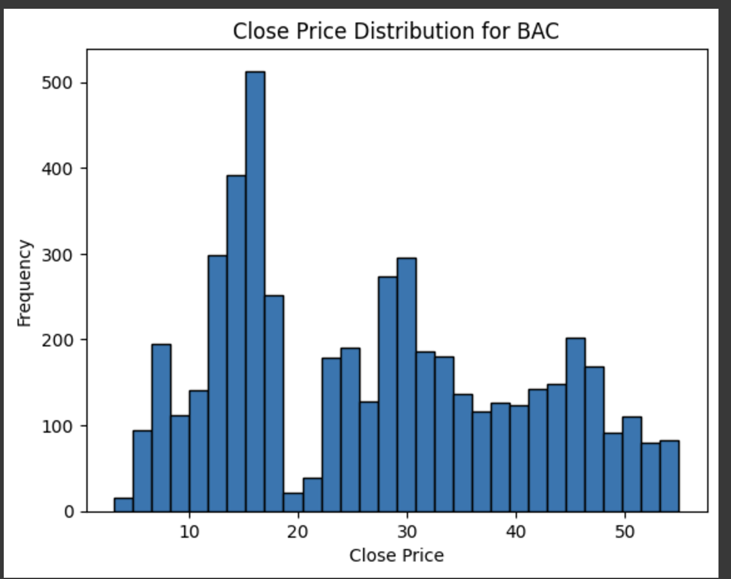
EXPLORATORY DATA ANALYSIS
The graph shows the daily returns of Bank of America (BAC) from 2004 to 2024, highlighting how the returns went up and down over time.
The graph shows the distribution of closing prices for Bank of America (BAC) stock.

Slide 9
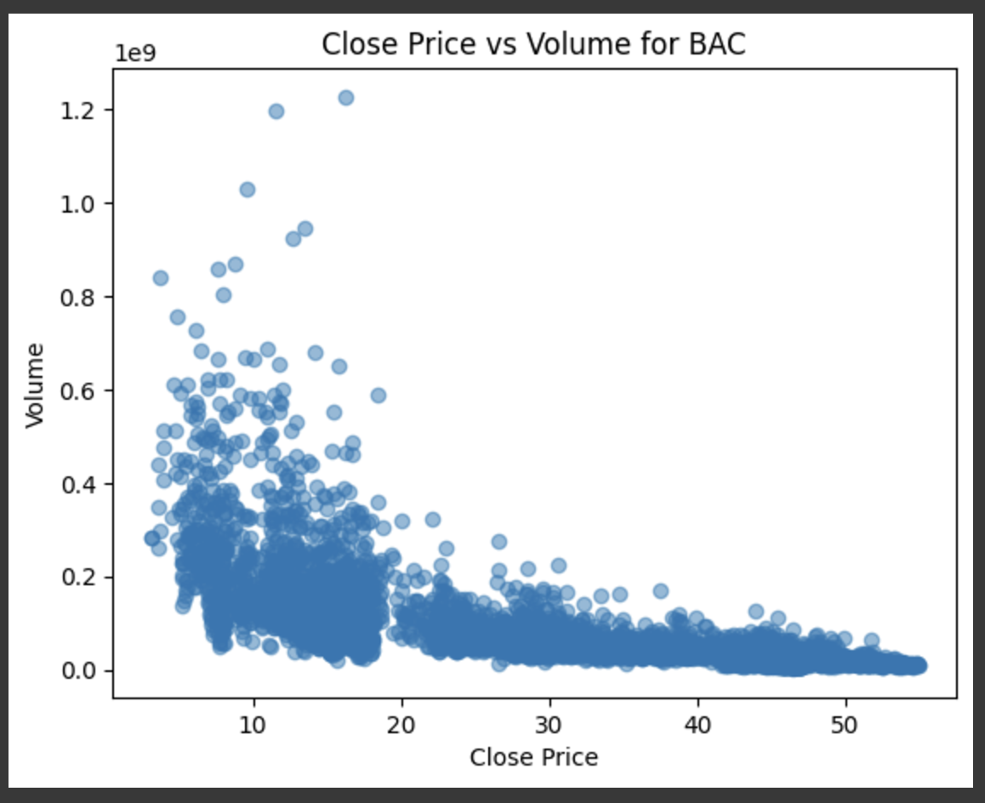
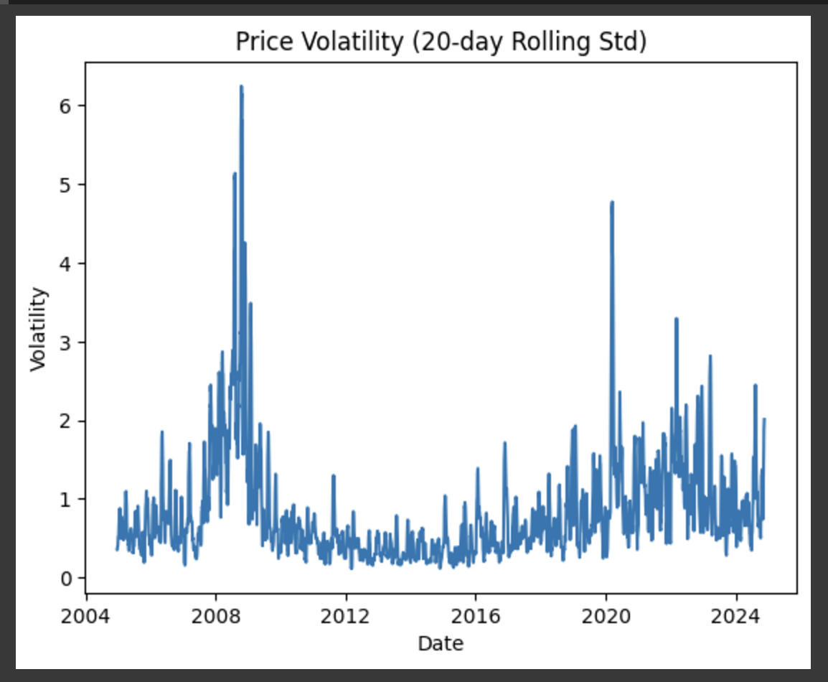
The graph shows the relation between BAC’s closing price and Trading volume
The graph shows the 20-day volatility of BAC’s stock prices from 2004 to 2024

Slide 10
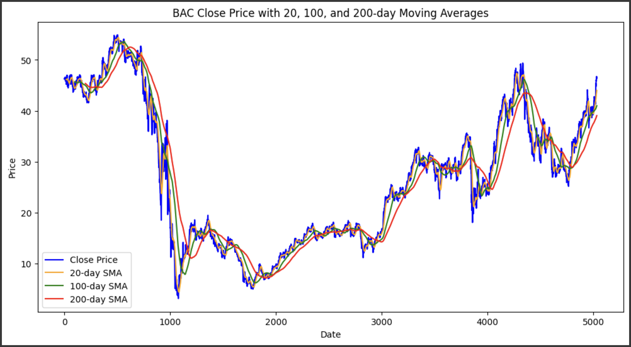
The graph displays Bank of America's closing price over time, along with 20-day, 100-day, and 200-day moving averages. These averages shows the stock's short-term and long-term trends, providing a clearer view of its overall price movement.

Slide 11
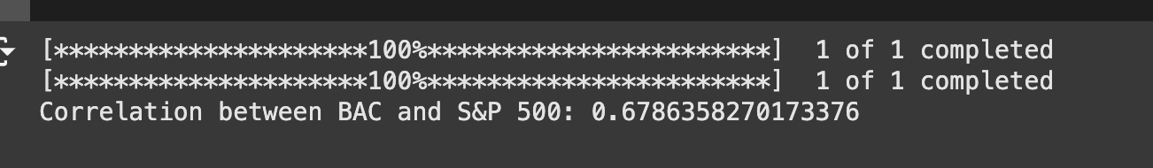
The S&P 500 is a stock market index that represents the performance of 500 large companies in the U.S. The code calculates the daily returns for both BAC and S&P 500 index, then determines their correlation.

Slide 12
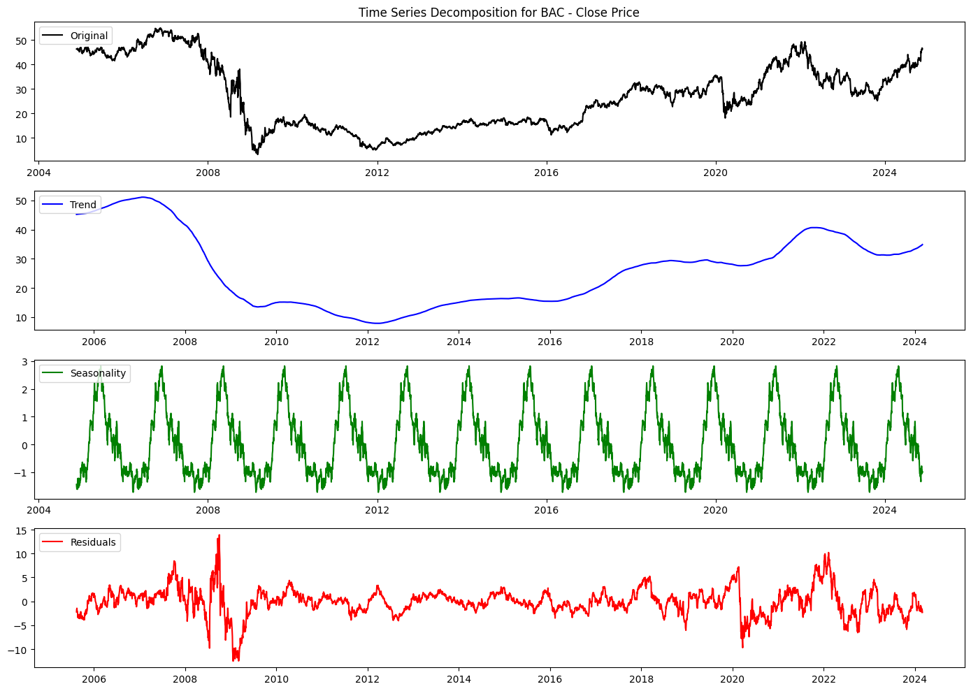
TIME SERIES ANALYSIS
Trend: The long-term movement or direction in the data over time.
Seasonality: Regular pattern or cycle in the data that repeats over a specific period.
Residual: Random variations or fluctuations in the data that cannot be attributed to trend or seasonality.
The dataset used in this project consists of historical stock market data for 10 major stocks collected from Yahoo Finance, spanning a 20-year period from 2004 to 2024.

Slide 13
MODEL TRAINING AND EVALUATION
Selected Models for Predictive Analytics
ARIMA
SARIMA
Support Vector Regressor
Random Forest Classifier
Decision Tree Regressor
XGradient Boosting Classifier
Training Methodology
Data Splitting: 80% training, 20% testing
Python Packages:
- `scikit-learn` for model operations.
- `pandas` and `NumPy` for data manipulation.
- `Matplotlib` and `Seaborn` for visualization.

Slide 14
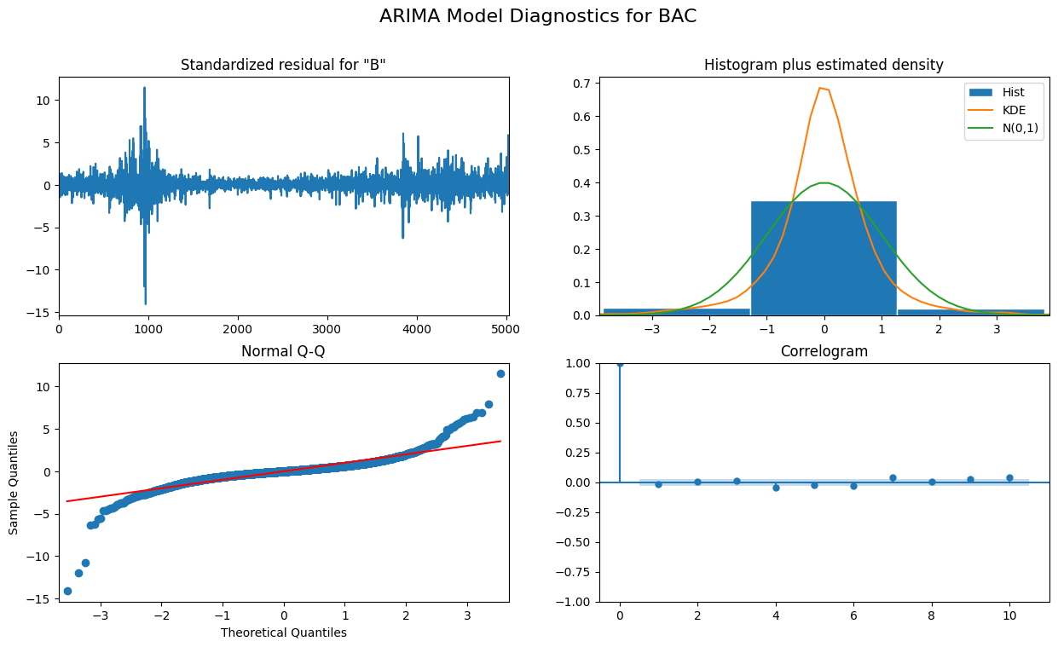
ARIMA(Autoregressive Integrated moving Average)

Slide 15
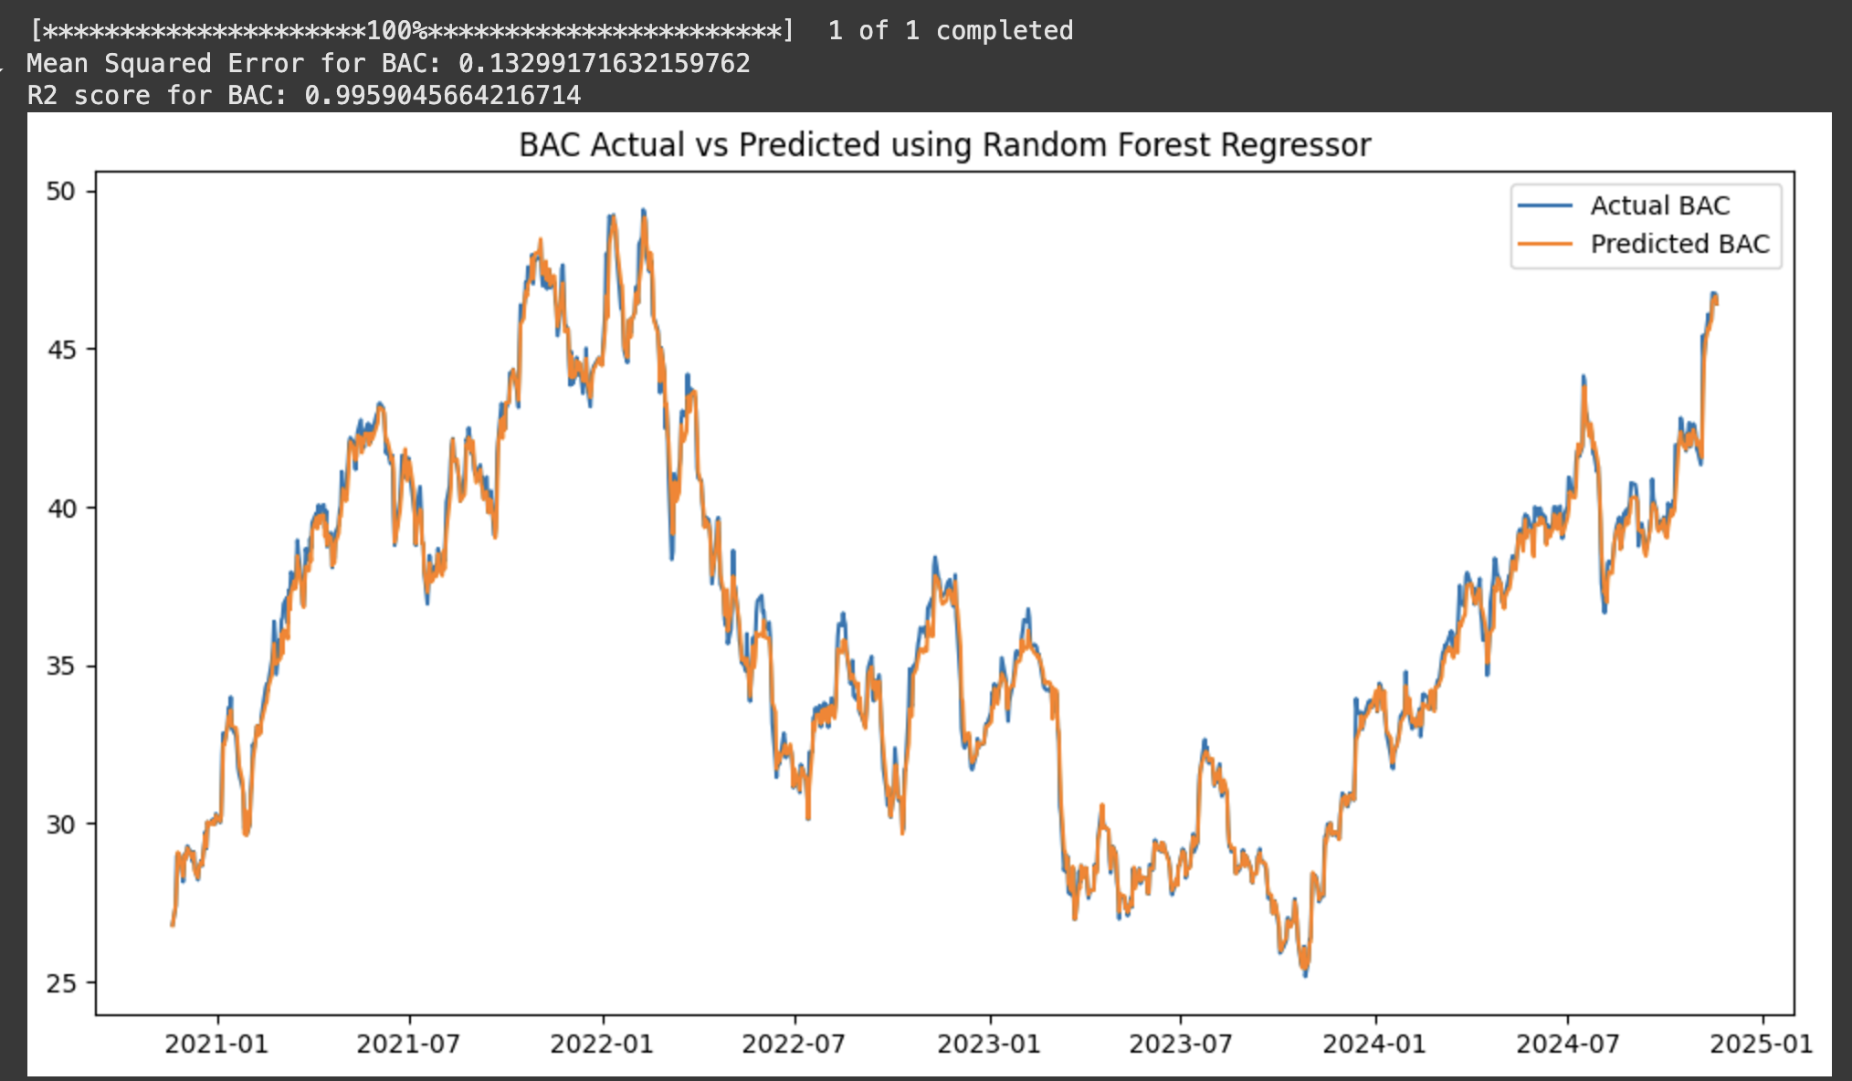
RANDOM FOREST REGRESSOR
The prediction prices closely follow the actual prices, showing the model's accuracy. The R² score of 0.995 indicates excellent performance, and the low mean squared error confirms minimal prediction errors.

Slide 16
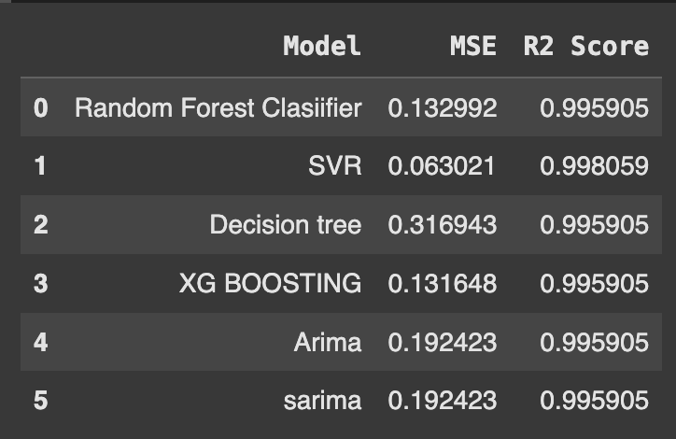
COMPARISON OF MODELS
SVR achieves the best accuracy with the lowest MSE (0.063021) and the highest R² score (0.998), while other models like Random Forest, XGBoost, and ARIMA also perform well with slight variations in error and accuracy.

Slide 17
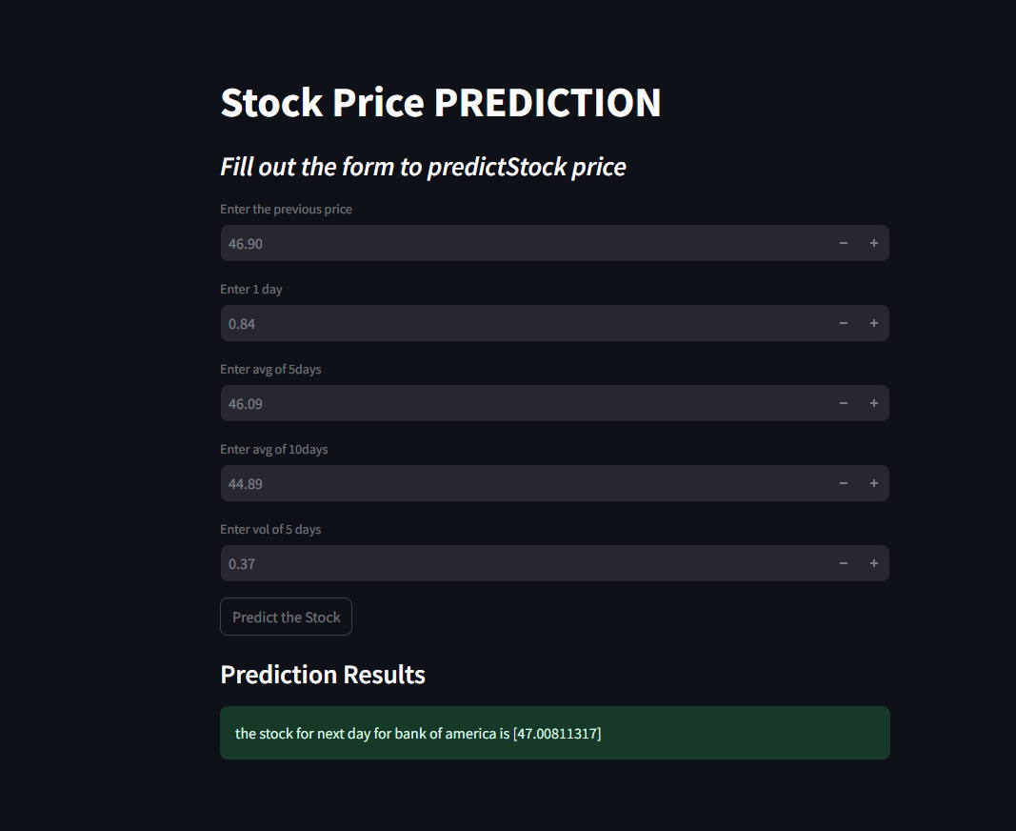
WEB APPLICATION DEVELOPMENT
I created a web app development using Streamlit to predict stock market trends using the SVR Model.
Link:
https://stock-price-prediction-606.streamlit.app/

Slide 18
CHALLENGES
Unpredictable Market Factors External influences like economic events, political disruptions, or natural disasters can be highly erratic and create challenges for model accuracy in stock market prediction.
Lack of Interpretability Machine learning models are often opaque, making it difficult to trace their reasoning or correct biases, which can limit trust in their predictions.
Data Sources Traditional data like financial reports may be insufficient for accurate predictions, while integrating new sources like social media can offer insights into market sentiment.

Slide 19
FUTURE WORK
Incorporating Additional Data Sources
To enhance prediction accuracy, we will incorporate additional data sources such as social media sentiment, economic indicators, and global news. By analyzing these data sources, we can gain a more comprehensive understanding of the market and make more informed predictions.

Slide 20
CONCLUSION
In conclusion, the project aimed to predict stock market trends using time series analysis and machine learning. It evaluated the performance of different machine learning models, including ARIMA, and other Machine learning models, and compared their results.
The use of time series analysis allowed us to identify patterns and trends in the stock market data, which were then used to train machine learning models. This approach is used to develop models that could accurately predict future stock prices based on historical data.

Slide 21

RESEARCH QUESTIONS?
Can historical stock prices and financial data be used to accurately predict future stock market trends?
Which model performs the best in terms of accuracy for stock market prediction?
Can feature selection improve the performance of predictive models in stock market analysis?
This Photo by Unknown Author is licensed under CC BY-NC

Slide 22
Thank you

